Slide 1

Market analysis
Notes:
4-5 mins

Slide 2

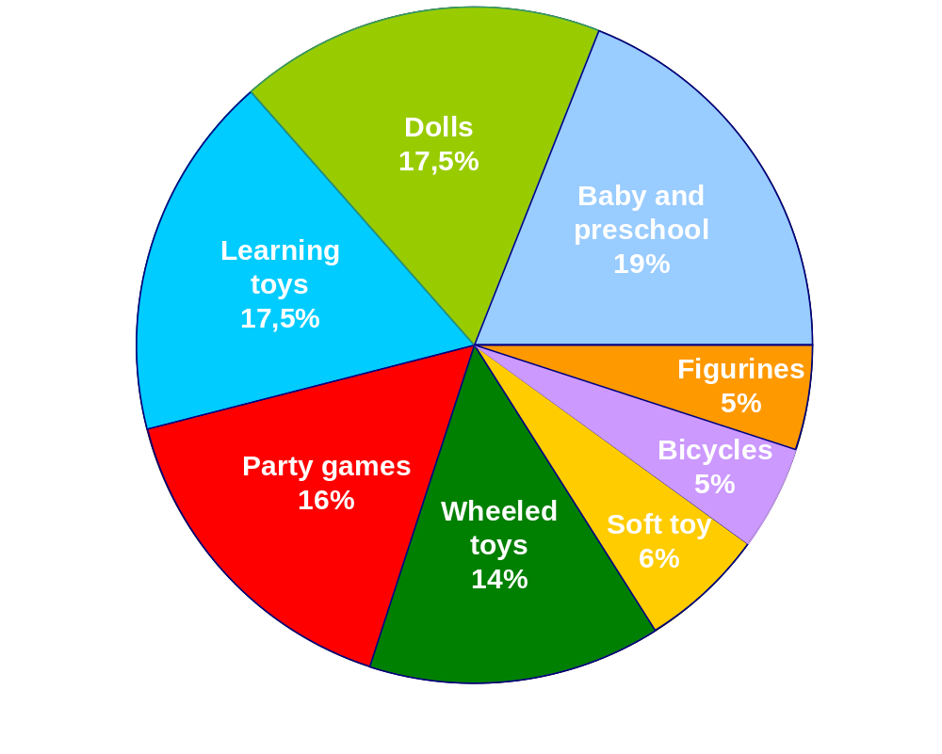
Global toy market segmentation without videogames

Slide 3
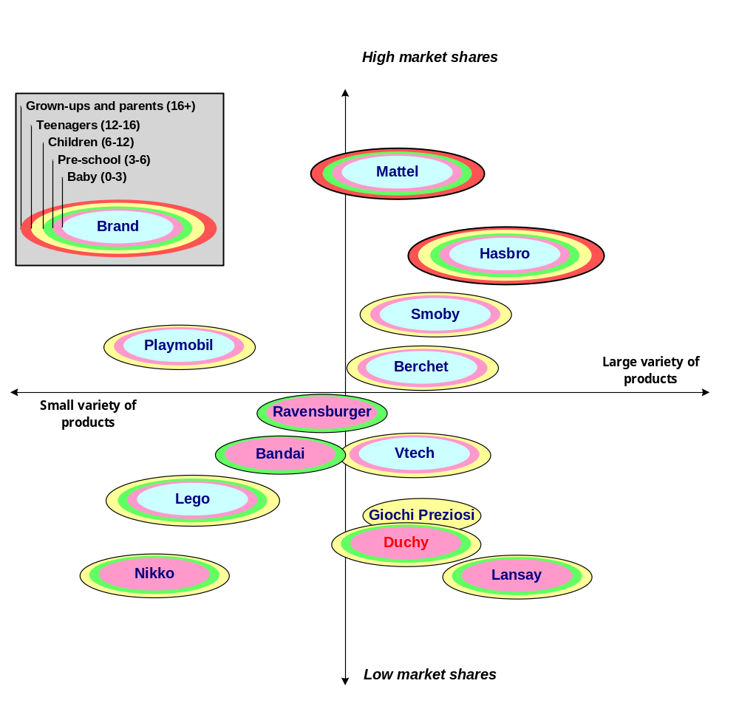
French toys/games market (without video games)

Slide 4
Strategic line
Notes:
4-5 mins
4-5 mins

Slide 5
SWAT ANALYSIS
STRENGTHS Image: quality collectors | WEAKNESSES High cost production Image : old fashion Lack of marketing expertise France only sells
OPPORTUNITIES Catalogue diversification Lead internationalization Increase in Baby Toy market | THEATS Price war Very strong competitors

Slide 6
Lead soldiers
Keep existent facilities and products
Add new distribution channels
Renegotiate packaging costs

Slide 7
Plastic toys
Adjust production planning
Find new products
Acquire labels

Slide 8
Sales and marketing policy
Notes:
10 Mins

Slide 9

ToyBox logo

Slide 10
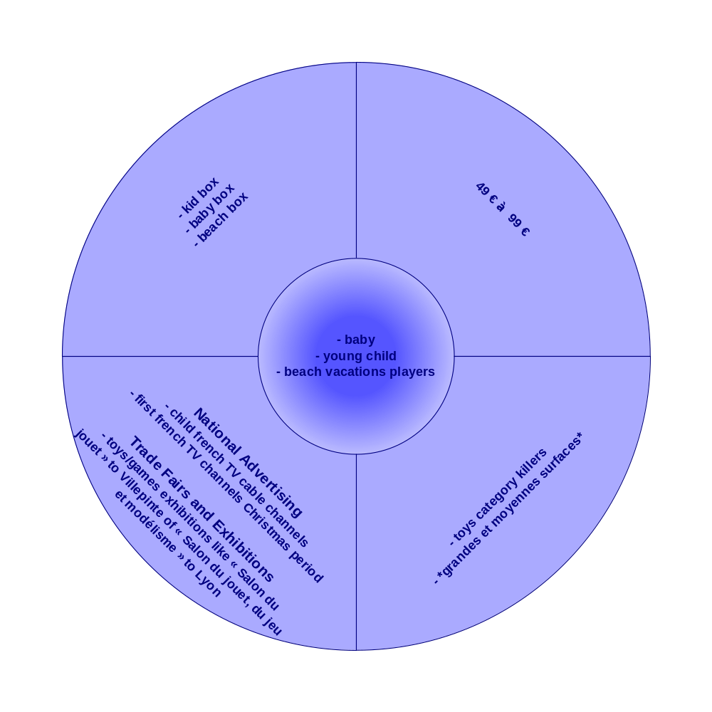
Sells and marketing plan

